Slide 1


ADHIYAMAAN COLLEGE OF ENGINEERING
(AUTONOMOUS)
DEPARTMENT OF COMPUTER SCIENCE AND ENGINEERING
A COMPUTER VISION-BASED METHOD FOR VEHICLE SPEED DETECTION USING VIDEO FOOTAGE
Team members(BATCH NO: C13):
SWEDHA M M (6176AC21UCS145)
THENMOZHI S (6176AC21UCS150)
THRISHA K (6176AC21UCS152)
VARSHINI V (6176AC21UCS158)
Guided by:
Mrs. M. Malathi M.E.,
AP/CSE

Slide 2
ABSTRACT
The web-based application allows users to upload video recordings of traffic, automatically detecting and tracking vehicles to estimate their speeds. By leveraging a combination of Haar Cascade for vehicle detection and Lucas Kanade(optical flow algorithm) for speed estimation, the system provides accurate and real-time insights. It also produces annotated video outputs highlighting vehicle speeds, offering valuable data for traffic management, road safety enforcement, and urban planning.

Slide 3
OBJECTIVES
To estimate vehicle speeds instantly from video footage, offering quick and accurate results.
To work with existing CCTV or security cameras, avoiding the need for extra hardware.
To detect vehicle movement using advanced algorithms for precise speed detection.
To use open-source tools and existing setups, making it an affordable option.
To handle multiple video formats, making it suitable for larger projects.
To have automated processing and easy-to-use interfaces.

Slide 4
EXISTING SYSTEM
Traditional speed measurement systems such as radar-based and LIDAR-based methods require dedicated, specialized hardware that must be installed at various points. Inductive loop sensors require embedding in road surfaces, necessitating physical alterations and installations.
Each new installation requires the setup of new radar or LIDAR units, or additional road sensors, which can be both costly and logistically challenging.
Disadvantages:
High maintenance costs due to the complexity and sensitivity of the equipment.
Requirement of regular calibration, repairs, and updates.
Installing radar, LIDAR, or inductive loop sensors involves complex procedures..

Slide 5
PROPOSED SYSTEM
The optical flow-based speed estimation system leverages existing CCTV cameras, which are already installed in many locations for surveillance purposes.
No need of additional hardware.
This reduces long-term operational costs and simplifies overall management.
The optical flow-based system integrates with pre-existing CCTV cameras, streamlining the deployment process.
Advantages:
Minimal physical changes and relies mainly on configuring and optimizing software for speed estimation.
Addition of more locations for speed estimation is simplified as it only requires access to existing cameras and the extension of software solutions.

Slide 6
LITERATURE SURVEY
S.NO | PAPER TITLE | AUTHOR(S) | PUBLICATIONS | WORK DONE
1. | Improving Vehicle Speed Estimation Accuracy Using Advanced Optical Flow Techniques | S. Patel and R. Jha | Journal of Real-Time Image Processing 2023 | Lucas-Kanade optical flow, focuses only on selected key points for motion estimation which is computationally efficient, making it more suitable for real-time processing.
2. | Real-Time Vehicle Speed Estimation Using Convolutional Neural Networks and Optical Flow | A. Kumar et al. | Pattern Recognition 2023 | The system avoids this dependency by using pre-trained Haar Cascade classifiers which require less retraining and can still perform well under a wide range of conditions.
3. | Vehicle Detection and Speed Estimation Using Optical Flow in Traffic Surveillance | L. Zhao et al. | Computer Vision and Image Understanding 2022 | By integrating Haar Cascade detection with optical flow, the system can better handle occlusions (even if vehicles are partially blocked).
4. | A Comparative Evaluation of Optical Flow Methods for Vehicle Tracking | M. B. Moghaddam et al | IEEE Transactions on Intelligent Transportation Systems 2021 | It provides classification of vehicles, filtering out non-vehicle objects and ensuring that the speed estimation applies only to relevant objects (vehicles).

Slide 7
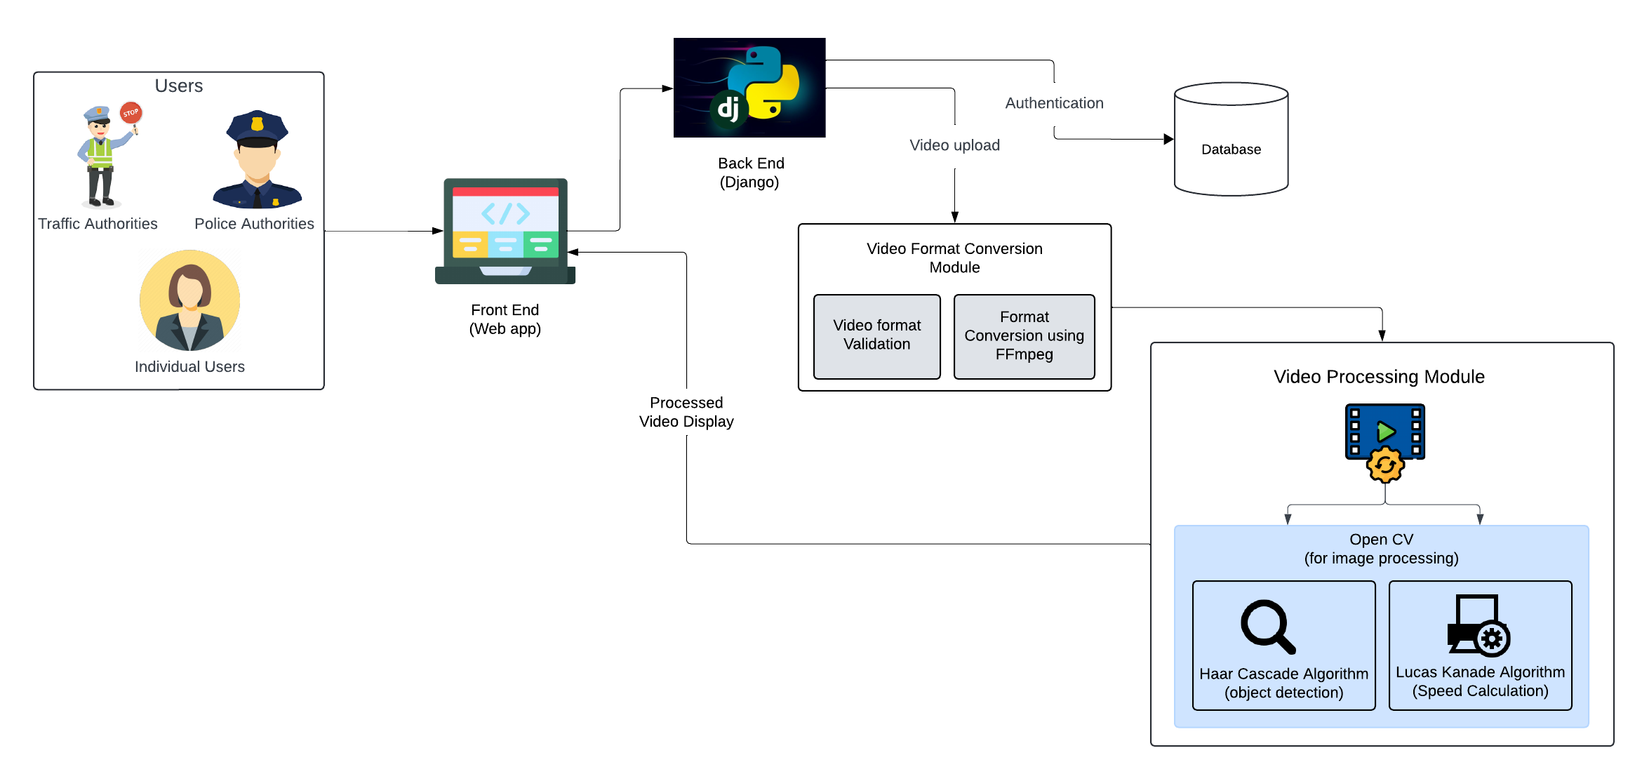
ARCHITECTURE

Slide 8
MODULES
Authentication Module
It manages user registration, login, and session management within the web app.
It ensures secure access control.
It allows only authenticated user to upload videos and view vehicle speed detection results.
Video Upload and Processing Module
Handles video validation, processing and conversion to the required format for analysis using OpenCV and FFmpeg.
3. User Interface (UI) Module
It provides a clean and intuitive frontend for interacting with the vehicle speed detection system.
It is responsible for uploading videos, viewing results, and navigating through the app’s features.

Slide 9
MODULES
4. Optical Flow & Speed Calculation Module
Implements Lucas-Kanade optical flow for more advanced vehicle tracking and speed estimation.
Enhances accuracy compared to the Haar cascade by tracking vehicle movements over consecutive frames.
Result Visualization Module
Displays the output video with vehicle speed annotated above the detected vehicles.
Option to download the processed video.
6. Error Handling & Video Format Conversion Module
Converts unsupported or browser-unreadable video formats into a compatible format using FFmpeg.
Ensures seamless video processing by handling multiple formats automatically.
Logs conversion errors for developer debugging, ensuring smooth user experience.

Slide 10
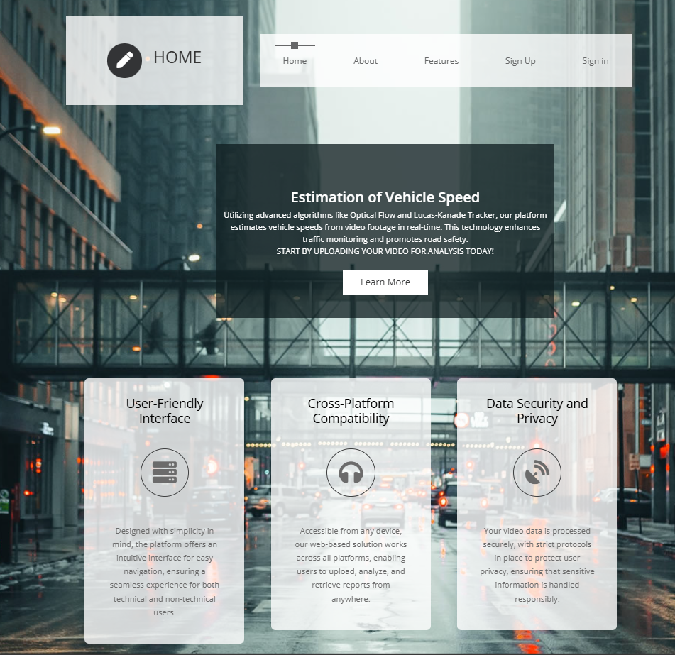


OUTCOMES
User Interface Module:

Slide 11


OUTCOMES
Authentication Module:

Slide 12

OUTCOMES
Upload and Processing module:

Slide 13
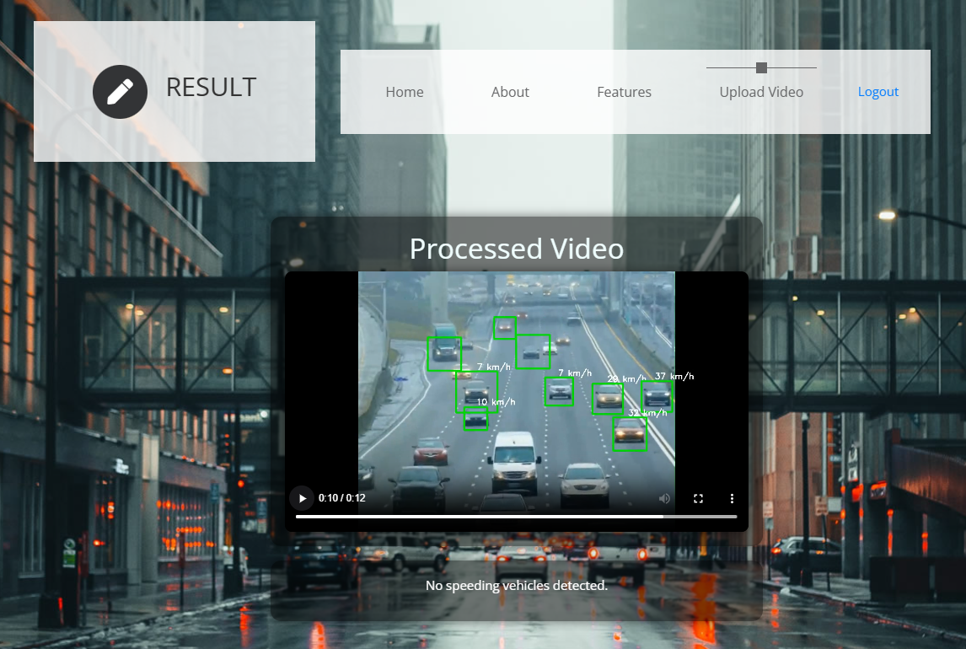
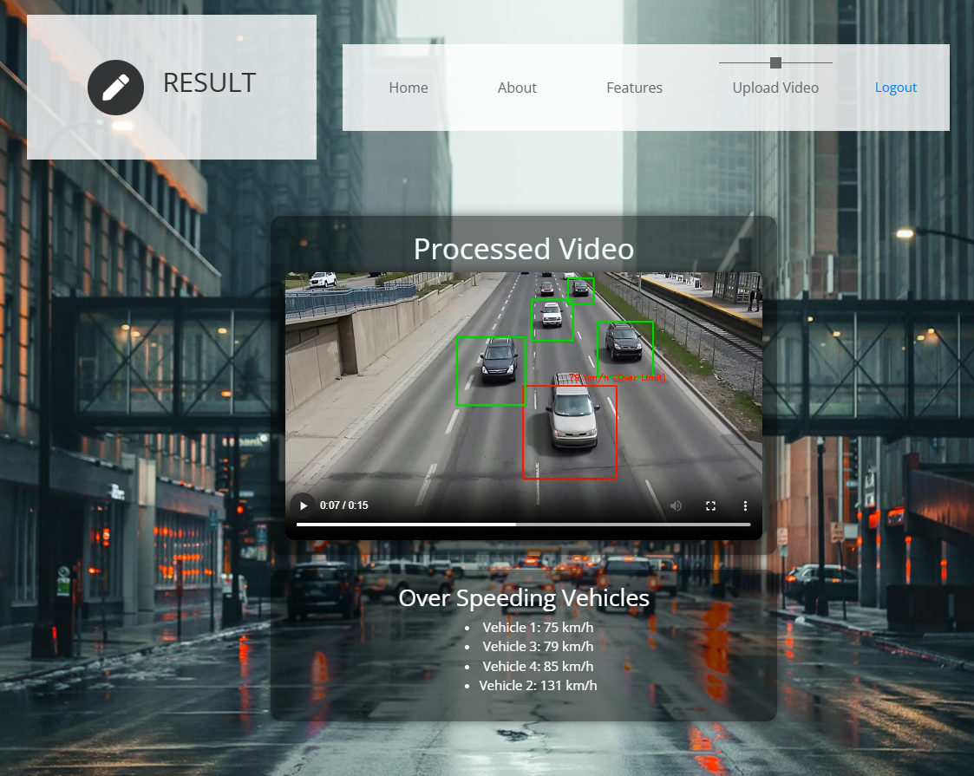
OUTCOMES
Result Visualization module:

Slide 14
CONCLUSION
The computer vision-based vehicle speed detection project successfully demonstrates a non-invasive, efficient approach to estimating vehicle speeds using recorded video footage. By combining the Haar Cascade algorithm for vehicle detection and optical flow for speed estimation, this system provides an accessible and cost-effective alternative to traditional, hardware-intensive methods. Built with OpenCV and Django, the project has proven capable of delivering accurate speed estimations, making it valuable for applications in law enforcement, traffic analysis, and insurance verification.

Slide 15
REFERENCES
1. Patel, S., & Jha, R. (2023).Improving Vehicle Speed Estimation Accuracy Using Advanced Optical Flow Techniques. [Journal of Real-Time Image Processing]
2. Zhang, Y., Wang, X., & Liu, J. (2022).Real-time Vehicle Detection and Speed Estimation Using Haar Cascade and Optical Flow. [IEEE Transactions on Intelligent Transportation Systems]
3. Singh, A., & Gupta, R. (2023). Comparative Analysis of Optical Flow Methods for Vehicle Speed Estimation in Urban Environments.[International Journal of Computer Applications]
4. Fernandez, J., & Ruiz, M. (2022).An Enhanced Framework for Real-time Traffic Analysis Using OpenCV and Optical Flow. [Journal of Computer Vision and Image Processing]
5. Kumar, R., & Sharma, N. (2023). Vehicle Speed Detection Using Haar Cascade and Optical Flow: A Machine Learning Approach. [Journal of Image and Video Processing]

